Slide 1
Machine Vision UFMFRR-15-M
Week 1: Introduction
Presentation by
Dr. Wenhao Zhang
Associate Professor of Computer Vision and Machine Learning
Codirector of the Centre for Machine Vision
04/10/2023

Slide 2

BB-ZW-TF
Check in code
https://myattendance.uwe.ac.uk/

Slide 3
In this lecture
Part A: Introduction to Machine Vision
Part B: Module structure, schedule, assessments…

Slide 4
AI
Machine
Learning
Machine
Vision
Deep Learning
Robotics

Slide 5
Machine Vision Is Easy

Slide 6
What is machine vision?
MACHINE VISION IS EASY: We don’t normally think of vision as requiring intelligence: after all, everyone who isn’t blind can do it—and so can squirrels
1970
Marvin Minsky at MIT asked his first-year student to:
GUESS WHAT HE SAID

Slide 7
An ambitious attempt in 1970s
MACHINE VISION IS EASY: We don’t normally think of vision as requiring intelligence: after all, everyone who isn’t blind can do it—and so can squirrels
Marvin Minsky at MIT asked his first-year student to:
“spend the summer linking a camera to a computer and getting the computer to describe what it saw”
(Boden 2006, p. 781)
Boden, M. A. (2006). Mind As Machine: A History of Cognitive Science. Oxford University Press, Oxford, England

Slide 8
An ambitious attempt in 1970s
- image captioning?
Image captioning: Automatically generate natural language descriptions according to the content in an image
Deep learning (e.g., recurrent neural network)

Slide 9
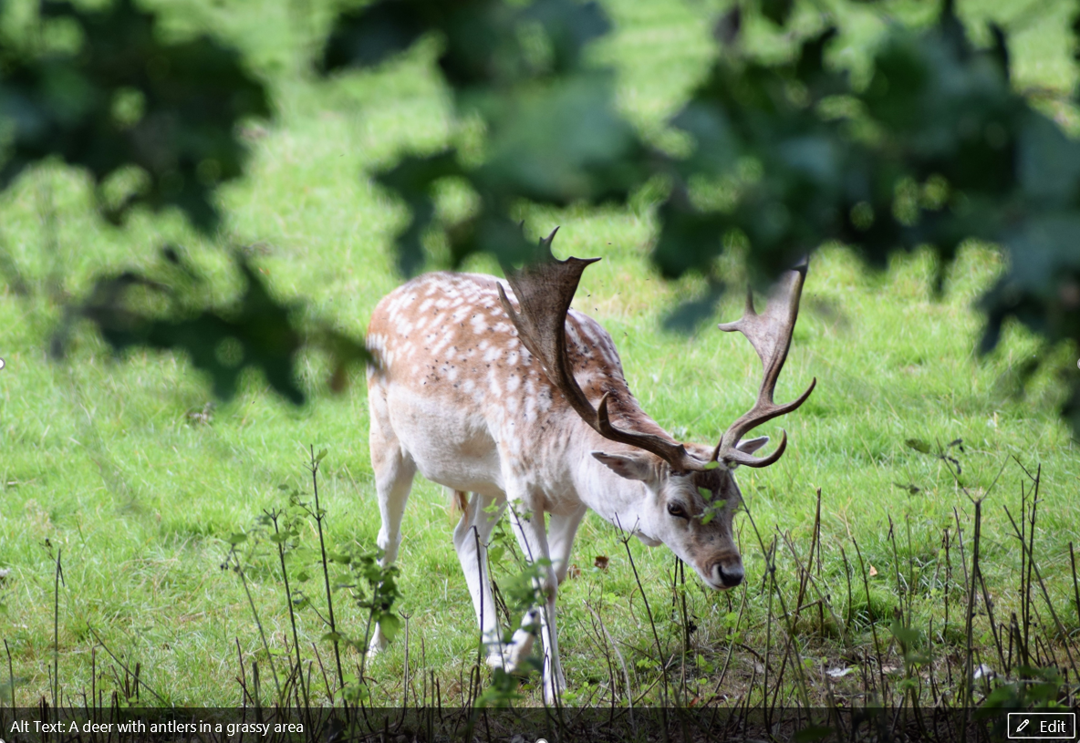
An example of image captioning

Slide 10

An example of image captioning
Notes:
https://www.youtube.com/watch?v=kb0iMO9yK-o&t=24s&ab_channel=MicrosoftResearch

Slide 11
1950
-
1970
What is machine vision?
Stereo triangulation
Digital image processing Computer vision/Machine vision
Shape from shading
Optical flow
1980
PATTERNS
LINES
SCENES
3D STRUCTURES
Face recognition
Features
2000
Learning
3D
Scene understanding
Synthesis
2010
Deep learning
2020

Slide 12
Machine Vision in year 2023
Advancements in:
Sensors
Data
Computing devices
Some examples:
3D face recognition
Object detection/tracking
Synthesis (Generative adversarial network)

Slide 13
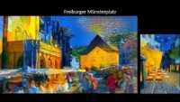
An example of Synthesis
Notes:
https://www.youtube.com/watch?v=Khuj4ASldmU&t=3s&ab_channel=ComputerVisionFreiburg

Slide 14
Pause and reflect
Give examples of problems that you think machine vision can solve or cannot solve in this day and age

Slide 15
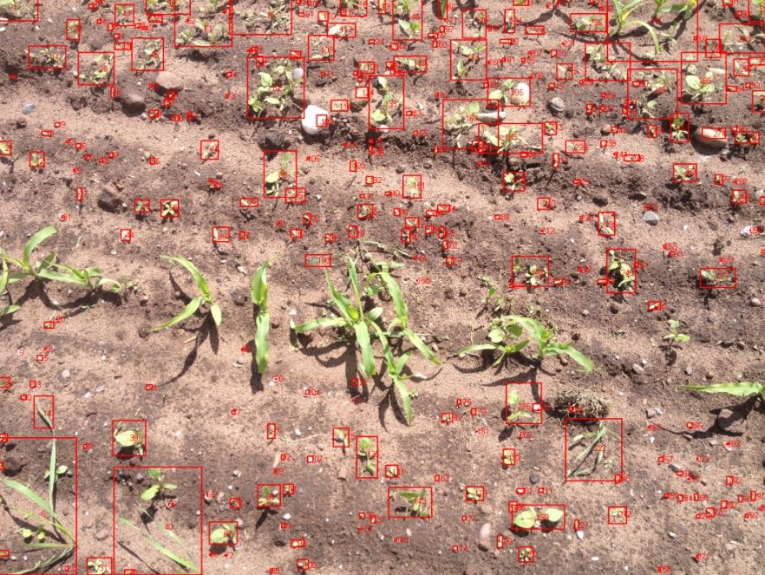
What is machine vision?
1. …recovers useful information about a scene from its two-dimensional projections (Jain, 1995).
Jain, R., Kasturi, R. and Schunck, B.G., 1995.Machine vision. New York: McGraw-Hill.

Slide 16
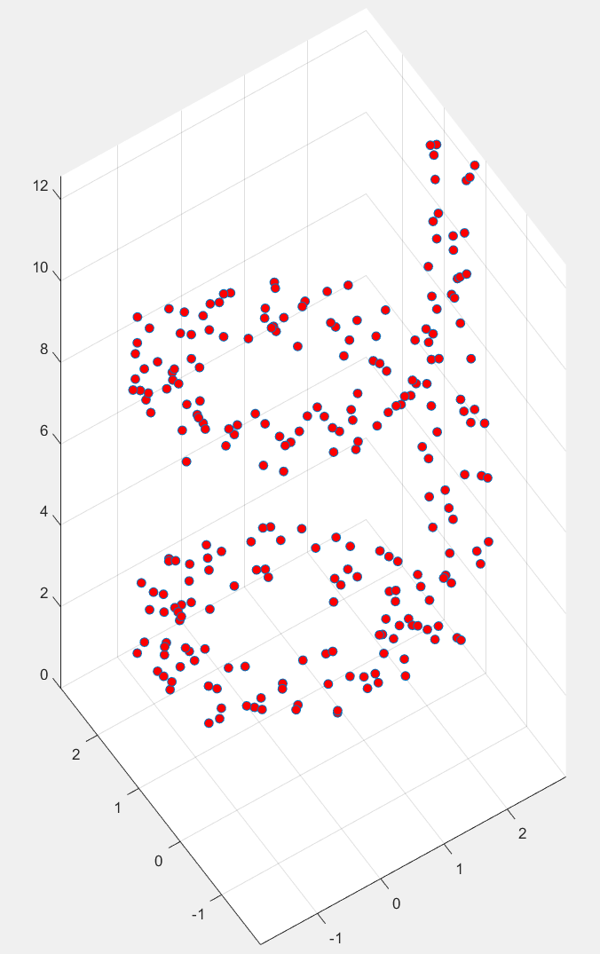

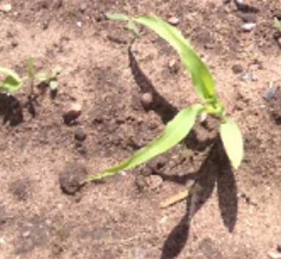
What is machine vision?
2. …an enterprise that uses statistical methods to disentangle data using models constructed with the aid of geometry, physics, and learning theory (Forsyth, 2002).
Forsyth, D.A. and Ponce, J., 2012. Computer vision: a modern approach. Pearson.

Slide 17


What is machine vision?
Physics and machine vision
e.g. The process by which light interacts with surfaces

Slide 18
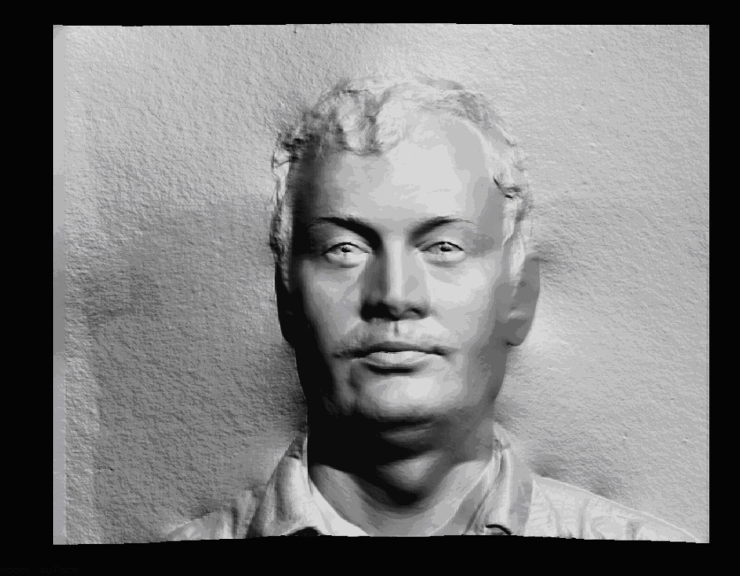
What is machine vision?
Physics and machine vision
e.g. The process by which light interacts with surfaces
e.g. Shape from Shading
3D -> 2D
2D -> 3D

Slide 19

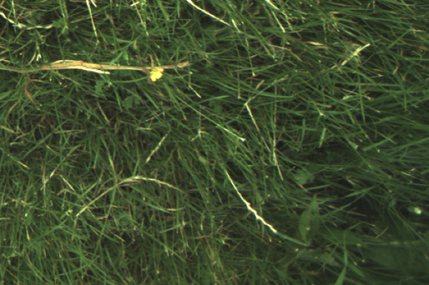
What is machine vision?
Learn rules from data, adapt to changes, and improve performance with experience
Learning theory and machine vision
e.g. Weed Detection in Pasture

Slide 20
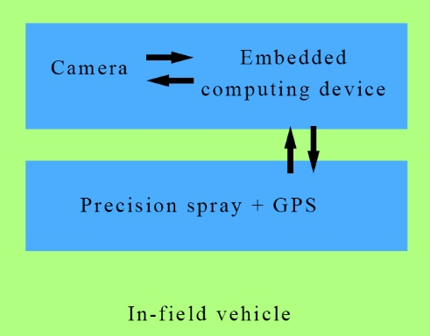


Example: Weed Detection in Pasture
Vision System

Slide 21
Example: Weed Detection in Pasture
Encoder
trigger
Nozzle control system triggered
Camera
yes
capture
Machine Vision
Machine Learning algorithms
Output:
Weed?
no

Slide 22
What is machine vision?
3. …an inverse problem, in which we seek to recover some unknowns given insufficient information to fully specify the solution (Szeliski, 2010).
Recover properties of scenes:
Shape
Illumination
Colour distributions
Why is machine learning difficult?
Do not underestimate the difficulty of the problem
Szeliski, R., 2010. Computer vision: algorithms and applications. Springer Science & Business Media.

Slide 23
Part B
Continued…

Slide 24
Intended learning outcomes
Appraise use of machine vision systems in differing domains.
Interpret the current key research issues in machine vision.
Identify requirements of an application task; formulate and constrain a machine vision problem.
Design and implement machine vision solutions to real-world problems and evaluate algorithm performance.
Explain, compare and contrast machine vision techniques including image acquisition, feature extraction and machine learning.

Slide 25
Contact Hours
Lecture (1 hour)
Delivered By:
Dr Wenhao Zhang Wenhao.Zhang@uwe.ac.uk
Dr Disi Chen Disi.Chen@uwe.ac.uk

Slide 26
Machine Vision exercises with
Python
and
Google Colaboratory
Contact Hours
Tutorial (2 hours)
Please check your timetable to make sure you attend the correct tutorial session
Tutored by:
Dr Disi Chen Disi.Chen@uwe.ac.uk
Dr Syed Yunas Syed.Yunas@uwe.ac.uk
Sign up for a Google account if you do not have one already.
Discuss with a tutor if you are unable to use a Google account.

Slide 27
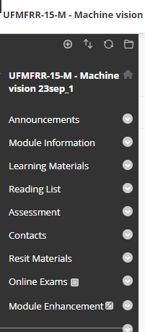
Using Blackboard

Slide 28
Assessment – component A (Jan)
Exam （online）
Weighting: 50%
Short-answer questions + Longer case study question(s)

Slide 29
Assessment – component B (9 Jan)
Written group project report
Weighting: 50%
5000 words, proposes and evaluates machine vision solutions to a given real-world problem
A group mark will be awarded to each group by tutors based on the quality of the Group Project Report.
To reflect individual contribution to the group-based activity, peer assessment will be used which may allocate a positive, a negative mark, or a 0 mark to each group member
48-hour late submission window available
14-day extension unavailable

Slide 30
Group work
Group work policy in Blackboard Module Page->Module Information
Recommended group size: 5 (min=4 and max=6)
Group formation to take place during tutorial this week

Slide 31
Group work
Read the Assignment Specifications (in Blackboard)
‘Speed dating’ with your peers during the first tutorial session
Make sure that your skills are complementary
Enrol to the same group in Blackboard with your other group members
Let the tutor know if there is any issue

Slide 32
Next week
Lecture: Image formation and representation
Tutorial: Images in Python

